Slide 1
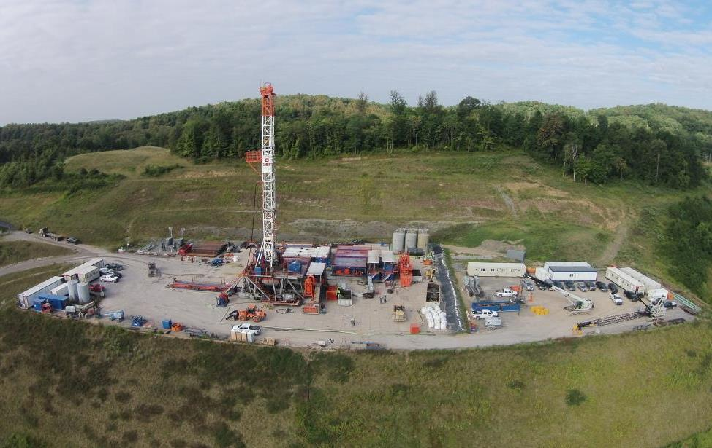
The Unconventional Energy Revolution
Shale Gas and CO₂
Tim Carr
West Virginia University
August 17 2016 – GeoCC16

Slide 2

Energy the Basis of Civilization
Promethean Energy Revolutions
Fire
  Warmth, Cooking,
  Forge Metals, Long Life
Heat Engine
  Power, Speed, Flight
Chemistry
  Fertilizer
  Plastics, etc., etc.
Emissions Management
  Particulates
  SO_{x}, NO_{x}, Hg
  CO₂
Pieter Paul Rubens:
''Prometheus Bound”
Philadelphia Museum of Art:
The W.P. Wilstach Collection
Notes:
Philadelphia Museum of Art: The W.P. Wilstach Collection
In Greek mythology, Prometheus defied the will of Zeus by stealing fire and giving it to the mortal race of men in their dark caves. Zeus was enraged by Prometheus' deceit, so he had Prometheus carried to Mount Caucasus, where an eagle would pick at his liver; it would grow back each day and the eagle would eat it again. Fire transformed mortal life by providing light, warmth, cooking, healing and ultimately the ability to smelt and forge metals, and to bake bricks, ceramics, and lime. Fire became the basis for the Greek culture and ultimately all Western culture. It is no wonder, therefore, that the Greeks attributed fire not to a mortal origin, but to a Titan, one of the godlike giants who were considered to be the personifications of the forces of nature.
If fire was the first Promethean energy technology, then Promethean II was the heat engine, powered first by wood and coal, and then by oil and natural gas. Like fire, heat engines achieve a qualitative conversion of energy (heat into mechanical work), and they sustain a chain reaction process by supplying surplus energy. Surplus energy or (net energy) is the gross energy extracted less the energy used in the extraction process itself. The Promethean nature of fossil fuels is due to the much larger surplus they deliver compared to animate energy converters such as draft animals and human labor.
The changes wrought by fossil fuels exceeded even those produced by the introduction of fire. The rapid expansion of the human population and its material living standard over the past 200 years could not have been produced by direct solar energy and wood being converted by plants, humans and draft animals. Advances in every human sphere—commerce, agriculture, transportation, the military, science and technology, household life, health care, public utilities—were driven directly or indirectly by the changes in society's underlying energy systems.
That is, until 1909, when the German chemist Fritz Haber discovered a process that could directly transform atmospheric nitrogen into plant-available nitrate using a high-temperature, energy-intensive process. This is today known as the industrial fixation of nitrogen, or the Haber-Bosch process.
It is estimated that half of the protein within human beings is made of nitrogen that was originally fixed by this process, whereas the other half comes from the organic cycle of nitrogen-fixing bacteria and archaea.

Slide 3
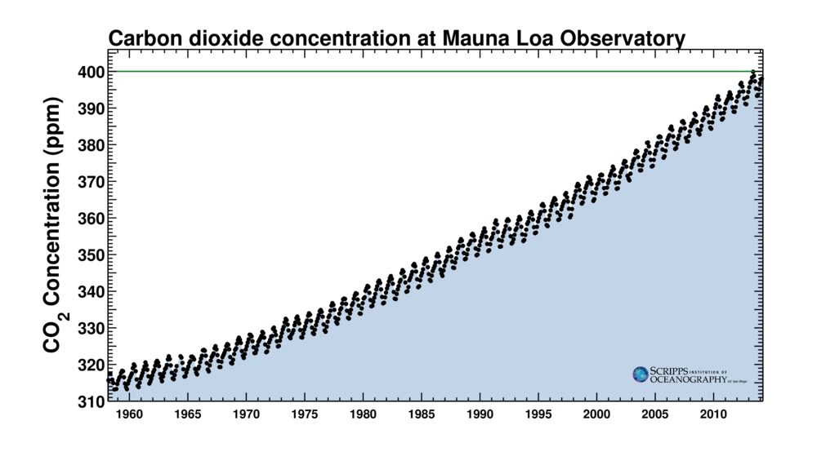
Atmospheric Carbon Dioxide
Chart shows a steady increase of CO₂ concentration in the last five decades. Although this chart is based on Mauna Loa’s data, the same trend has been found in many other places.

Slide 4
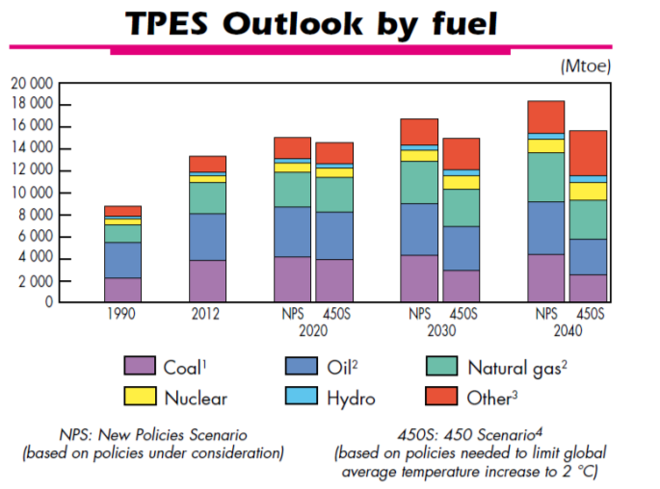
Fossil Fuels Dominate
IEA -Key World Energy Statistics, 2015
"suggesting that renewables will let us phase rapidly off fossil fuels in the United States,
China, India, or the world as a whole is almost the equivalent of believing in the
Easter Bunny and Tooth Fairy.” James Hansen (grandfather of climate change)

Slide 5

Supply Challenge
Today, 1.6 billion people–one quarter of the world population have no access to electricity.
In 2030, 1.4 billion people 17% of the world population will still not have electricity.
2.4 billion people rely on traditional biomass–wood, agricultural residues and dung–for cooking and heating.
Provide clean water and sanitation to avoid waterborne diseases that kill 1.5 million children under five every year.
Notes:
provide safe drinking water and sanitation to prevent water borne diseases such as diarrhea that account for one in ten child deaths – causing an estimated 1.5 million under-five deaths every year. It kills more young children than AIDS, malaria and measles combined. But if you mean fossil energy to provide refrigeration to provide amoxicillin that could save 600,000 children under five from death from pneumonia each

Slide 6
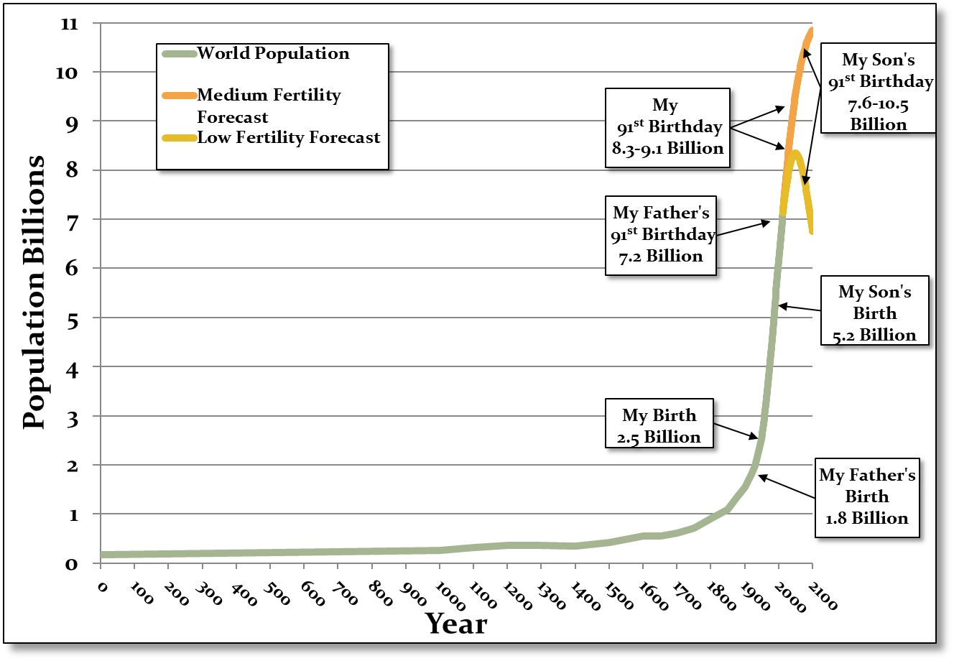
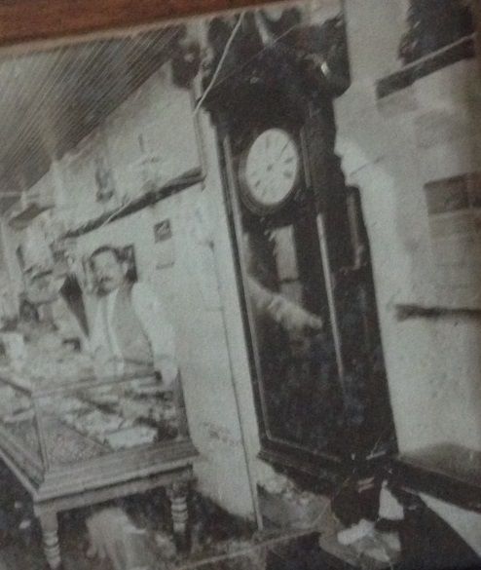

Supply Challenge
Clock built by my Great-Great-Great Grandfather and the same clock today in my parent’s house.
UNDP 2013 and Various Sources
Notes:
One of three clock built by my Great-Great-Great Grandfather Seth Hoke for his three sons returning from the Civil War. Picture is of my Great-Great Grandfather’s (William Seth Hoke) shop (~1910) showing his clock in Winchester, IN. Each clock is handed down through the maternal side (oldest daughter) and the same clock as picture is in my parents house and keeping perfect time. Clock was built in 1863-64.

Slide 7
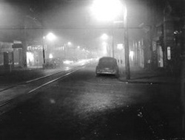

Emissions Challenge
Philadelphia Inquirer
http://news.bbc.co.uk/2/hi/uk_news/england/2546563.stm
Philadelphia Inquirer
On Friday, December 5 1952, a dense smoke-filled fog shrouded London and it hung over the city for the next four days. London came to a standstill. Over 4,000 people died, motor vehicles were abandoned, trains were disrupted, and airports were forced to close.
In Donora, Pennsylvania, in of October of 1948, after a killer fog caused 20 deaths, the government took heed and began air clean up.
Carnegie Museum of Art, Claude Monet's "Waterloo Bridge, London" (1903)
Notes:
Carnegie Museum of Art
In Londontown: Claude Monet's "Waterloo Bridge, London" (1903).
http://www.cmoa.org
In pictures: The Great Smog of London
http://news.bbc.co.uk/2/hi/uk_news/england/2546563.stm
BBC News

Slide 8

Emissions Challenge
Source NASA

Slide 9
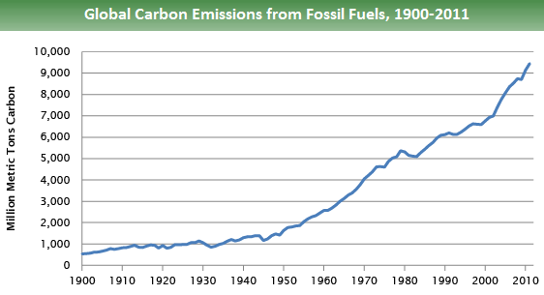
Emissions Challenge
Source: Boden, T.A., Marland, G., and Andres R.J. (2015)

Slide 10
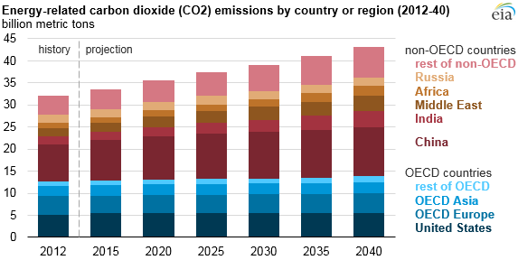
Global CO₂ Emissions

Slide 11
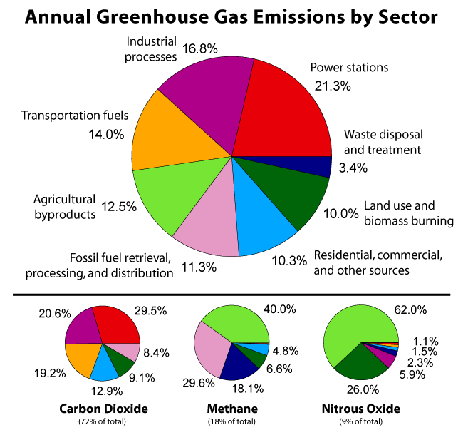
Human Activity and Greenhouse Gases
Source ACS - Global Warming Art Greenhouse Gas by Sector
2000 Data

Slide 12
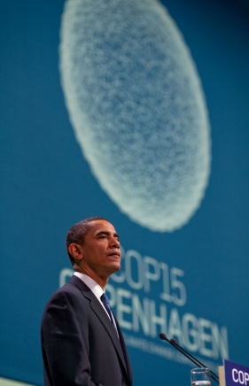
Intended Nationally Determined Contribution
On March 31, 2015, the U.S. communicated its INDC - as well as information to facilitate the clarity, transparency & understanding of the INDC, to the UNFCCC.
The U.S. INDC reflects an extensive, rigorous interagency planning process to identify and assess opportunities to deliver emission reductions by 2025.
A number of existing laws, regulations, and other domestically mandatory measures are relevant to the implementation of the target.
Source: www.whitehouse.gov
U.N. Framework Convention on Climate Change (UNFCCC) Conference

Slide 13
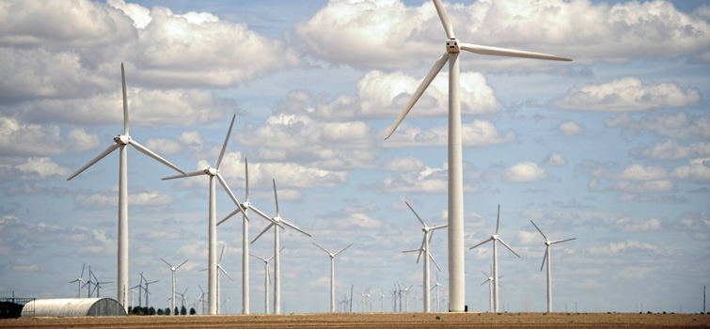


Quadrennial Technology Review
Economic Prosperity Requires Low Cost Energy
Energy Security Requires Abundant Domestic Resources
Low Carbon Economy Requires Reduction of Greenhouses Gases
http://energy.gov/sites/prod/files/2015/09/f26/Quadrennial-Technology-Review-2015_0.pdf

Slide 14
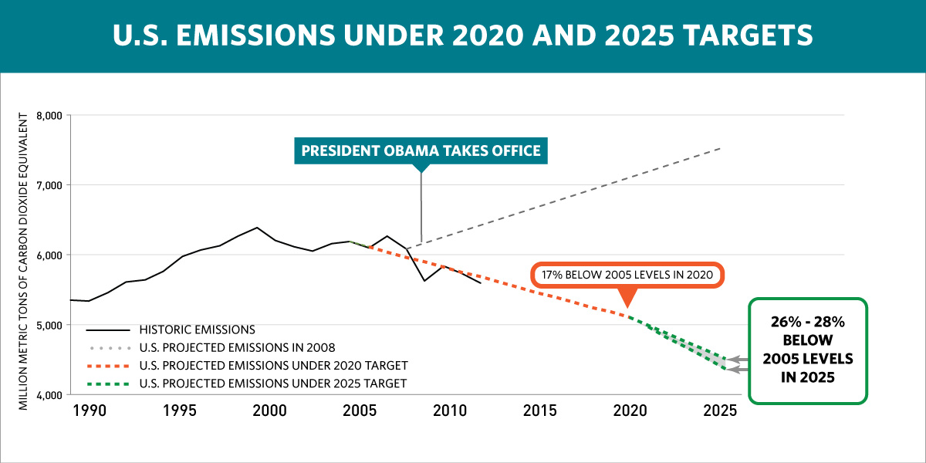
2025 Target
Our target is a 26-28% reduction below 2005 levels in 2025, making best efforts to achieve a 28% reduction.
This goal is ambitious and achievable, grounded in an intensive analysis of what can be done under existing law
Source: US EPA GHG Inventory
Notes:
Source: US EPA GHG Inventory

Slide 15
US Clean Power Plan
Implementation of the Clean Power Plan (CPP)
  Reduction of CO2 Emissions to 1,550 million metric tons (MMT) in 2040, substantially below 2005 (2,416 MMT) and 2015 (1,891 MMT)
  Coal’s share of total generation 18% in 2040 from 50% in 2005 and 33% in 2015.
Even without CCP, Electricity CO2 emissions will be well below 2005 levels
  2016 Forecast: 1st year natural gas-fired electricity generation exceeds coal generation in the US on an annual basis.
  Natural gas distribution system is changing at a rate not seen since WW II
  Electric grid is changing at an unprecedented pace
Even without the CPP, electricity-related CO2 emissions remain well below their 2005 level.
Notes:
In the proposed Clean Power Plan, EPA calculates the emissions reduction targets for individual states through application of a Best System of Emissions Reduction (BSER). The BSER consists of four building blocks which represent approaches to reducing CO2 emissions rates from existing fossil fuel-fired generators as calculated for purposes of compliance:
Building block 1: Improving the thermal efficiency of individual affected sources (heat rate improvement)¹⁰
Building Block 2: Dispatching the generating fleet to substitute less-carbon-intensive affected sources for more-carbon-intensive affected sources (re-dispatch for reduced emissions)
Building Block 3: Expanding the use of low- or zero-carbon generation in order to displace affected sources (low- and zero-carbon capacity expansion)
Building Block 4: Employing the use of demand-side energy efficiency to reduce overall generation required from affected sources (demand-side energy efficiency)¹¹In determining state goals, EPA begins by calculating an affected fossil generation emissions rate, in pounds of CO2 emissions per megawatt hour of electricity generated, based on 2012 historical data for each state. EPA then applies the building blocks of the BSER to arrive at each state’s interim and final emission rate performance goals. The Clean Power Plan proposes that states begin to reduce CO2 emissions from affected electric generating units by 2020 in order to reach final CO2 emission performance goals, measured in pounds of CO2 emitted per megawatthour of electricity generated from affected electric generating units, by 2030. The Clean Power Plan also proposes that states meet interim CO2 emission performance goals, on average, over the 10-year compliance period from 2020-29.¹² The state-level emissions rates as calculated by EPA for 2012, as well as the interim targets for 2020-29 and the final targets for 2030 and beyond, specified in the proposed Clean Power Plan are provided in Appendix C, Table 25.
It is critical to recognize that while the BSER building blocks are used to establish state-level goals, each state has discretion in designing implementation plans to achieve outcomes that meet the goals. Two or more states may also cooperate to meet their combined goals jointly.
The state-level emissions performance goals under the proposed Clean Power Plan are not based on a simple emission rate calculation (emissions divided by generation) for generation provided by existing fossil-fired electric generating units. Rather, the goals are established and compliance is assessed using a formula that provides varying treatment of specific generation sources and demand-side efficiency programs that can displace CO2 emissions from existing generating units that are regulated under the Clean Power Plan proposal. For example, unlimited amounts of new and existing zero-emission non-hydropower renewable generation are included in the generation base used to calculate compliance, which makes the non-hydropower renewable generation more valuable for compliance than existing hydropower and new and existing nuclear generation that do not receive similar treatment. The proposed Clean Power Plan formula also considers efficiency programs that reduce load as equivalent to zero-emission generation that counts in the base for the compliance calculation, even though some of the generation that is avoided by reduced load may have already been served by zero-emission generation sources.

Slide 16
Need to Address Non-Electric Sector
Mike Howard , EPRI , August 1, 2016

Slide 17
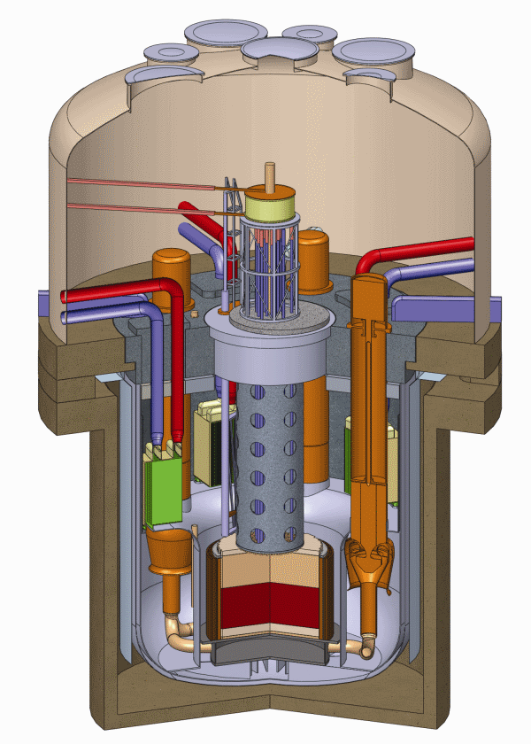
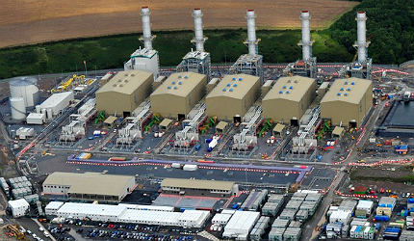

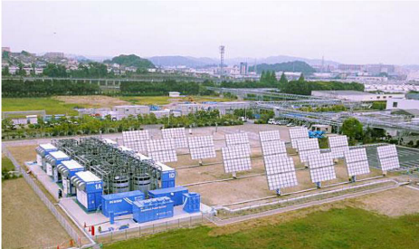
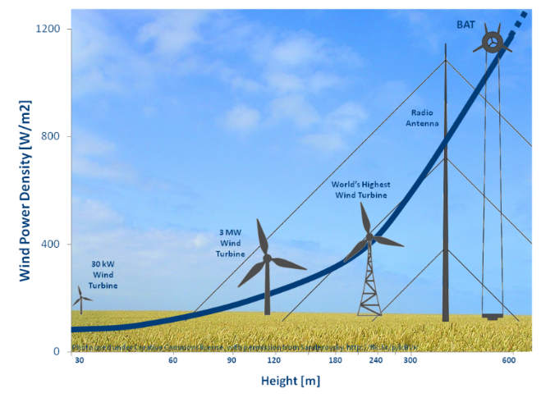
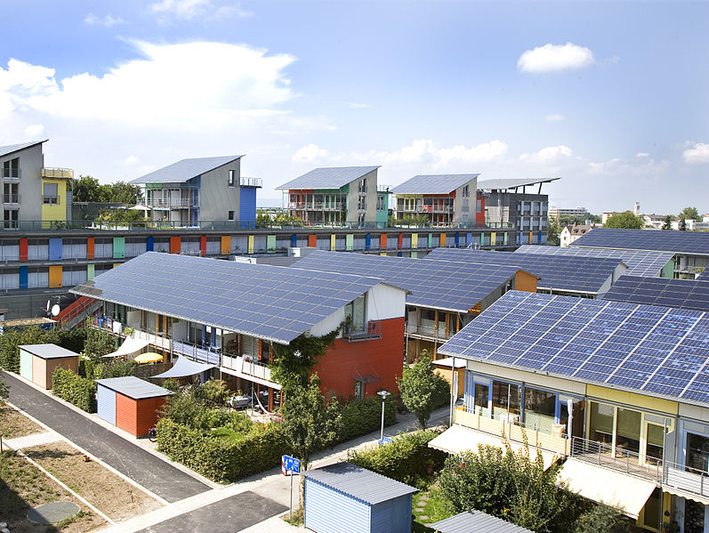
Pathways to Producing Cleaner Energy
Carbon Capture and Sequestration
Generation IV Nuclear
CCGT Gas-Fired Power
Large Scale Storage
High-Altitude Wind
Gen III Photovoltaic (PV)
Notes:
Regenesys polysulfide flow battery www.regenesys.com
Large-Scale Storage
(e.g., Regenesys Flow Battery)
Solar - https://commons.wikimedia.org/wiki/File:SoSie%2BSoSchiff_Ansicht.jpg
Gen III Photovoltaic (PV)
(e.g., High power density PV cells)
http://www.htcco2systems.com/
Coal and Gas Carbon Capture and Sequestration
http://euanmearns.com/high-altitude-wind-power-reviewed/
High-Altitude Wind
Generation IV Nuclear
(co-production –electricity, hydrogen steam)
http://www.power-technology.com/features/featurenuclear-waste-disposal-reactor-technology-recycle-clean-energy/featurenuclear-waste-disposal-reactor-technology-recycle-clean-energy-4.html
Pembroke combined cycle gas turbine (CCGT) power plant
http://www.power-technology.com/projects/pembroke-combined-cycle-power-plant/pembroke-combined-cycle-power-plant1.html

Slide 18
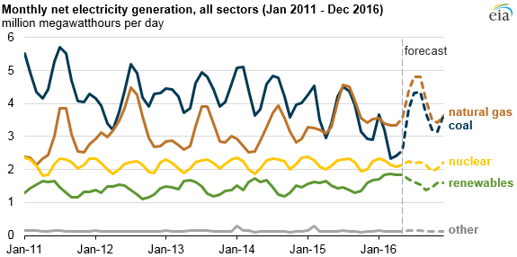
Natural Gas Electricity Production
Source: EiA

Slide 19

Duke Energy: Moving Toward a Lower Carbon Footprint and Increased Fuel Diversity
Total Company Fuel Diversity Estimates (MWh output)
Coal
Nuclear
Natural Gas/Oil
Hydro, Wind & Solar
Reduction of U.S. Generation Emissions From
2005 - 2015⁽²⁾
Reductions in emissions due to the following actions:
Additions of pollution control systems
Decreased coal generation
Retirement of higher-emitting plants
Increased natural gas generation
CO₂ 28% SO₂ 90% NO_{X} 68%
2006 data does not include Progress Energy .
Data based on Duke Energy’s ownership share of generating assets as of the end of each calendar year. The data exclude emissions from the commercial Midwest generation assets sold in April 2015, and include emissions from the NCEMPA generation assets (partial ownership interest in several Duke Energy Progress plants) purchased in August 2015.

Slide 20
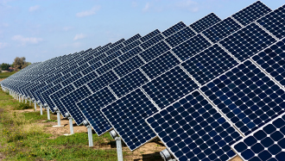
Grid Flexibility Assessment
Key Questions To Answer
What will the ramping requirements look like in future?
When will these occur?
How much flexibility is available from a set of resources?
Is the available flexibility sufficient to meet future net load ramps?
Source: EPRI 2016

Slide 21
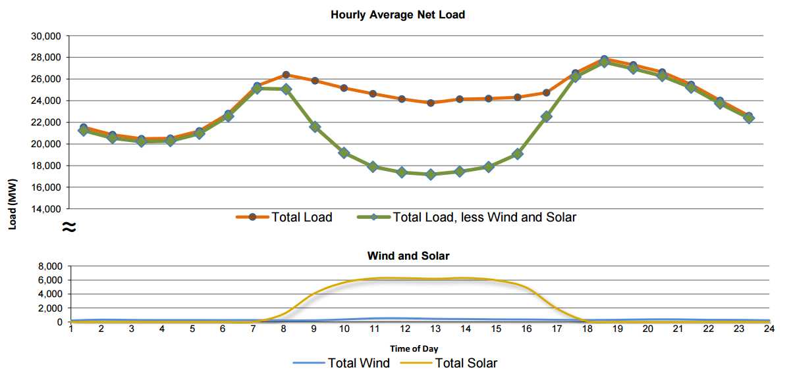
Example: California Load Shape
It’s not just Europe!
CAISO Net Load
Evening ramp: 9 GW/3h
Daily Min Load: 1 pm
Source: EPRI 2016
Source: CAISO Daily Renewables Watch – Feb 5, 2016
Notes:
CA presently at 10,900 MW, with 3500 MW added in 2014; 700 MW in 2015 Q1 -- approx. 6500 MW at time of plot

Slide 22
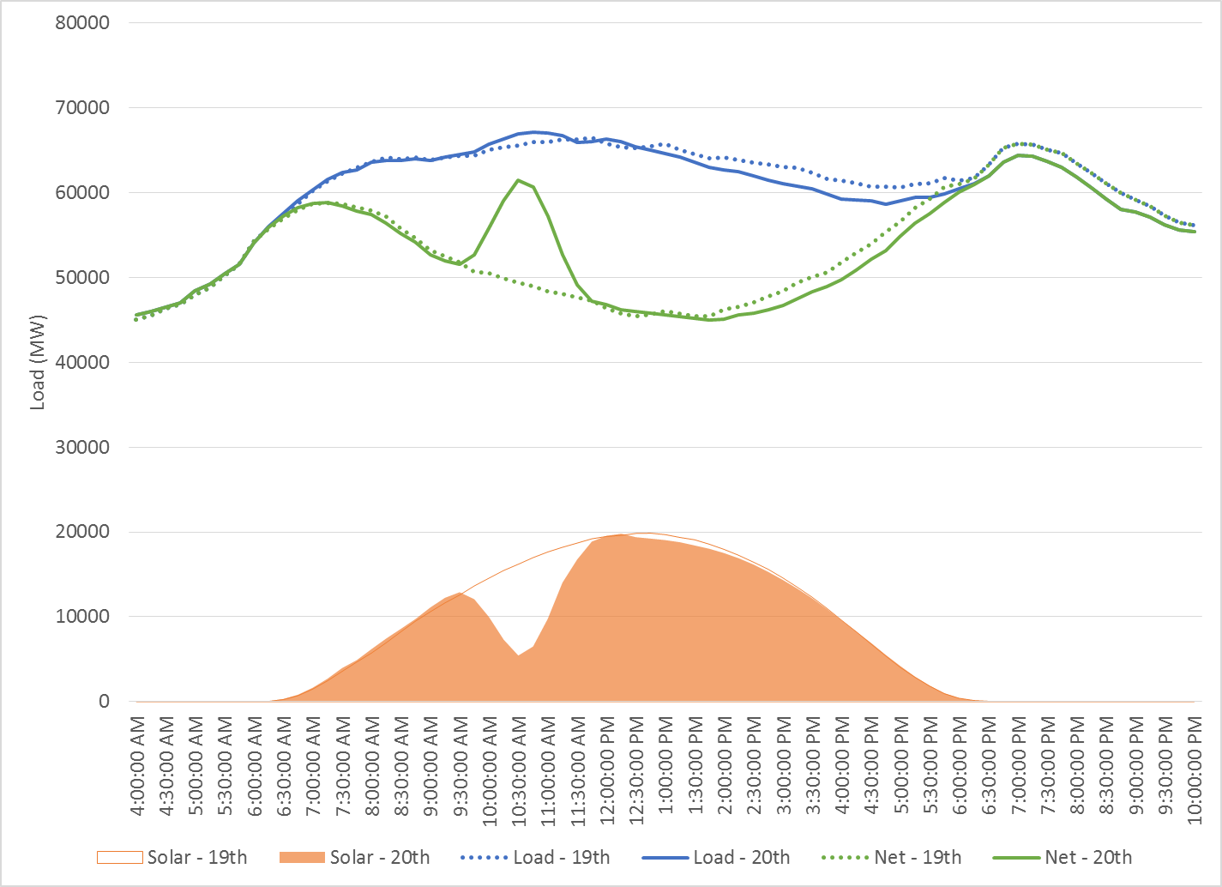
When Do We Need Grid Flexibility?
German Solar Eclipse Example
Additional 500 MW of up ramping in 15 minutes
Largest 15-min solar ramp increases by 70%
Lost 1/3 of solar energy from 9.45 am and 11.30 am
Increase in net load ramp covered by operating reserves
Source: German TSO data
Need ramping capability for variability and uncertainty over multiple time periods
Both physical and institutional sources of flexibility are important
Ramping needs during eclipse will be higher, but reflect future needs on the system

Slide 23
Power Sector CO_{2e} Emissions
Source: EIA
Notes:
Paris Agreement
• 2020 Target – 17% below 2005 levels
• 2025 Target – 26-28% below 2005 levels

Slide 24
The Shale Revolution affects everything. Technology has made quadrillions of BTUs of new energy resources available to humanity.
Costs and Benefits
  Largest Increase in Oil and Gas Production in the World
  Decreased Energy Prices
  Electrical Grid is changing at an unprecedented rate
  Reduced CO2 Emissions
Potential Environmental Challenges and Opportunities
  Greenhouse Gas Emissions
  Local Air, Noise and Water Pollution
  Major Infrastructure Changes
Goal: Minimize Environment Costs While Maximizing Benefits
While energy markets are complex, energy predictions are simplified representations of energy production and consumption, regulations, and producer and consumer behavior, and are subject to much uncertainty.
Notes:
CO₂ emissions in 2020 in the Reference case are more than 9 percent below the 2005 level of 5,996 million metric tons, and they still are below the 2005 level at the end of the projection period (5758 million metric tons in 2035).
Natural Gas Prices 2012 YTD are $2.86 down from $4.32 last YTD which is a decrease of 33.8% (July 2012).

Slide 25
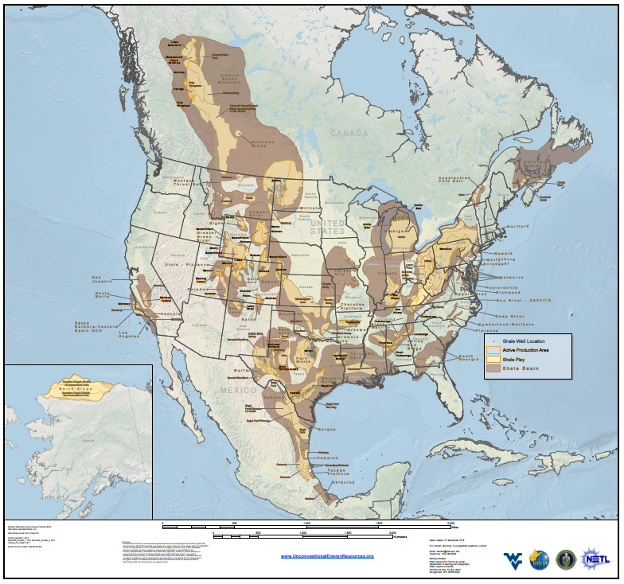
North America Mudrock Basins
Utica
Marcellus
http://www.unconventionalenergyresources.com/
Notes:
North America shale basins showing the location of active and potential unconventional oil and gas “shale” plays. Active shale gas and oil plays that have been assessed as part of a study funded in part by the National Energy Technology Laboratory of the US Department of Energy are highlighted. Active areas of the Utica and Marcellus shale plays are labeled. Information is available online at (http://www.unconventionalenergyresources.com/).

Slide 26
US Natural Gas Resources
Source: Potential Gas Committee, 2015
Notes:
The Potential Gas Committee (PGC) today released the results of its latest biennial assessment of the nation’s natural gas resources, which indicates that the United States possesses a total technically recoverable resource base of 2,515 trillion cubic feet (Tcf) as of year-end 2014. This is the highest resource evaluation in the Committee’s 50-year history, exceeding the previous high assessment (from 2012) by 131 Tcf. The increase arose from reevaluations of shale gas resources in the Atlantic, Mid-Continent, Gulf Coast and Rocky Mountain areas, and conventional/tight gas resources in the Mid-Continent and Rockies.
These changes have been assessed in addition to 53 Tcf of domestic marketed-gas production estimated by the EIA for the two-year period since the Committee’s previous assessment.

Slide 27
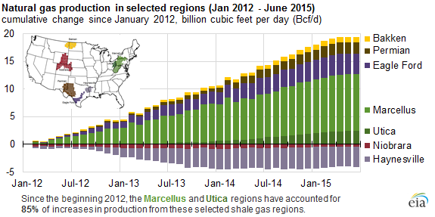
Marcellus Shale

Slide 28
U.S. Oil Production
April 28, 2016

Slide 29
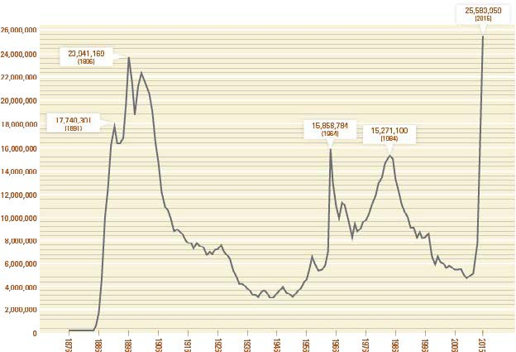
Ohio Liquids Production
82%
Kell, Ohio DNR

Slide 30
US Energy Forecast
Source: EIA

Slide 31
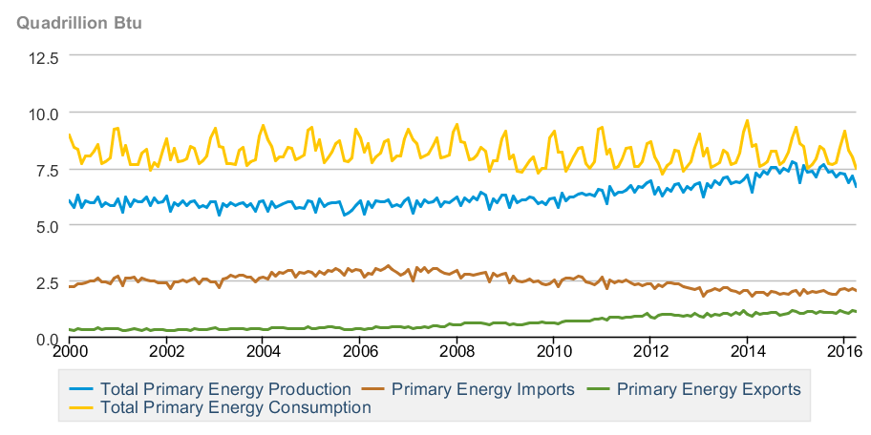
US Energy Forecast
Source: EIA

Slide 32
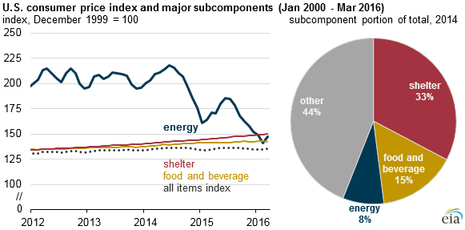
Energy Price Impact
Source: International Energy Agency, 2013 Key World Energy Statistics

Slide 33
Appalachian Basin Flow Data
RS Energy Group

Slide 34
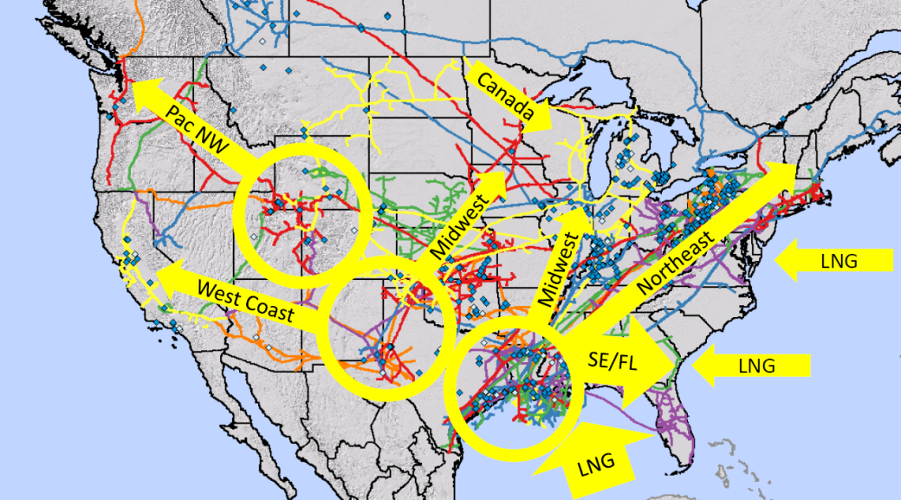
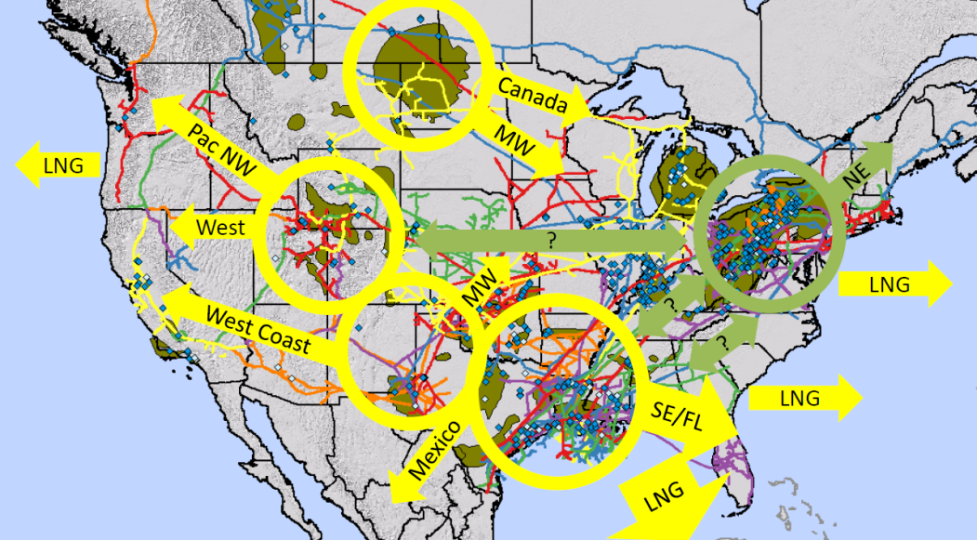
Growth in Shale Impacts Pipeline Flow
After Shale Production Growth
Significant pipeline infrastructure build out occurring in Northeast to move growing production North, West and South.
Currently 11.02 BCF/day¹ of LNG export permitted and under construction at six facilities in LA, TX and Maryland.
Before Shale Growth
Before Shale Production Growth
Pipelines flowing South to North to serve Southeast, Midwest and Northeast.
US LNG import capability expanded from ~4.5 BCF/Day to ~17 BCF¹ between 2005 and 2011 to contribute to balance US supply and demand.
After Shale Growth
¹Source; 2009 Capacity as of Feb. 6, 2009; 2011 Capacity as of July 6, 2011, April 4, 2016.
Images Source: America Natural Gas Alliance (now part of the American Petroleum Institute)

Slide 35
North America LNG Projects
Source: Wood Mackenzie

Slide 36
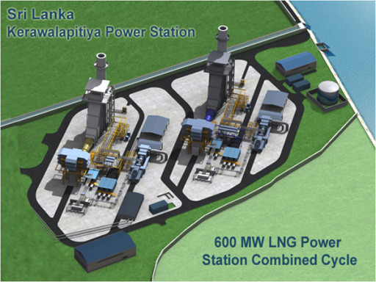
LNG Increased Global Trade
Sri Lanka will cancel plans for a 500 megawatt Indian-built coal-fired power plant at its strategic eastern port city of Trincomalee and will instead opt for a liquefied natural gas (LNG) power plant.
http://in.reuters.com/article/sri-lanka-india-coal-idINKCN0Y90R8
Notes:
http://in.reuters.com/article/sri-lanka-india-coal-idINKCN0Y90R8

Slide 37
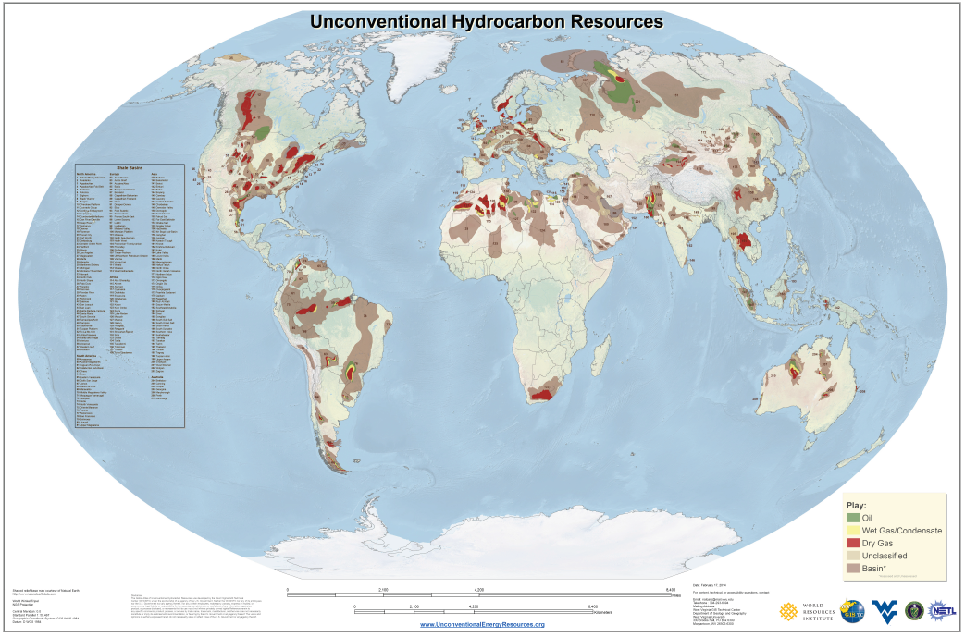
Global Shale (Mudrock) Basins
http://www.unconventionalenergyresources.com/
Notes:
North America shale basins showing the location of active and potential unconventional oil and gas “shale” plays. Active shale gas and oil plays that have been assessed as part of a study funded in part by the National Energy Technology Laboratory of the US Department of Energy are highlighted. Active areas of the Utica and Marcellus shale plays are labeled. Information is available online at (http://www.unconventionalenergyresources.com/).

Slide 38
Shale Revolution Affects Everything
New Ideas and New Technology
Horizontal Drilling and Hydraulic Fracture Stimulation have been Around for Decades
The Shale Boom has Emerged from Smart Development
  3D Seismic - Map
  Down Hole Sensors While Drilling - Headlights
  Steerable Bits and Precision Guidance – Steering Wheel
  Microseismic, Tiltmeters and Fiber-optics to Monitor Stimulation – Headlights
  Computerized Pump and Blending Controls – Steering Wheel
Real-Time Data Integration
  Remote Access
  Automated Rigs
  Closed Loop Systems
  Computer-Controlled Power - Bifuel, CNG and LNG
A Drilling Rig is a Computer with a Drill Bit Attached to One End
  Petabytes of Data Generated with Each Well
Notes:
CO₂ emissions in 2020 in the Reference case are more than 9 percent below the 2005 level of 5,996 million metric tons, and they still are below the 2005 level at the end of the projection period (5758 million metric tons in 2035).
Natural Gas Prices 2012 YTD are $2.86 down from $4.32 last YTD which is a decrease of 33.8% (July 2012).

Slide 39
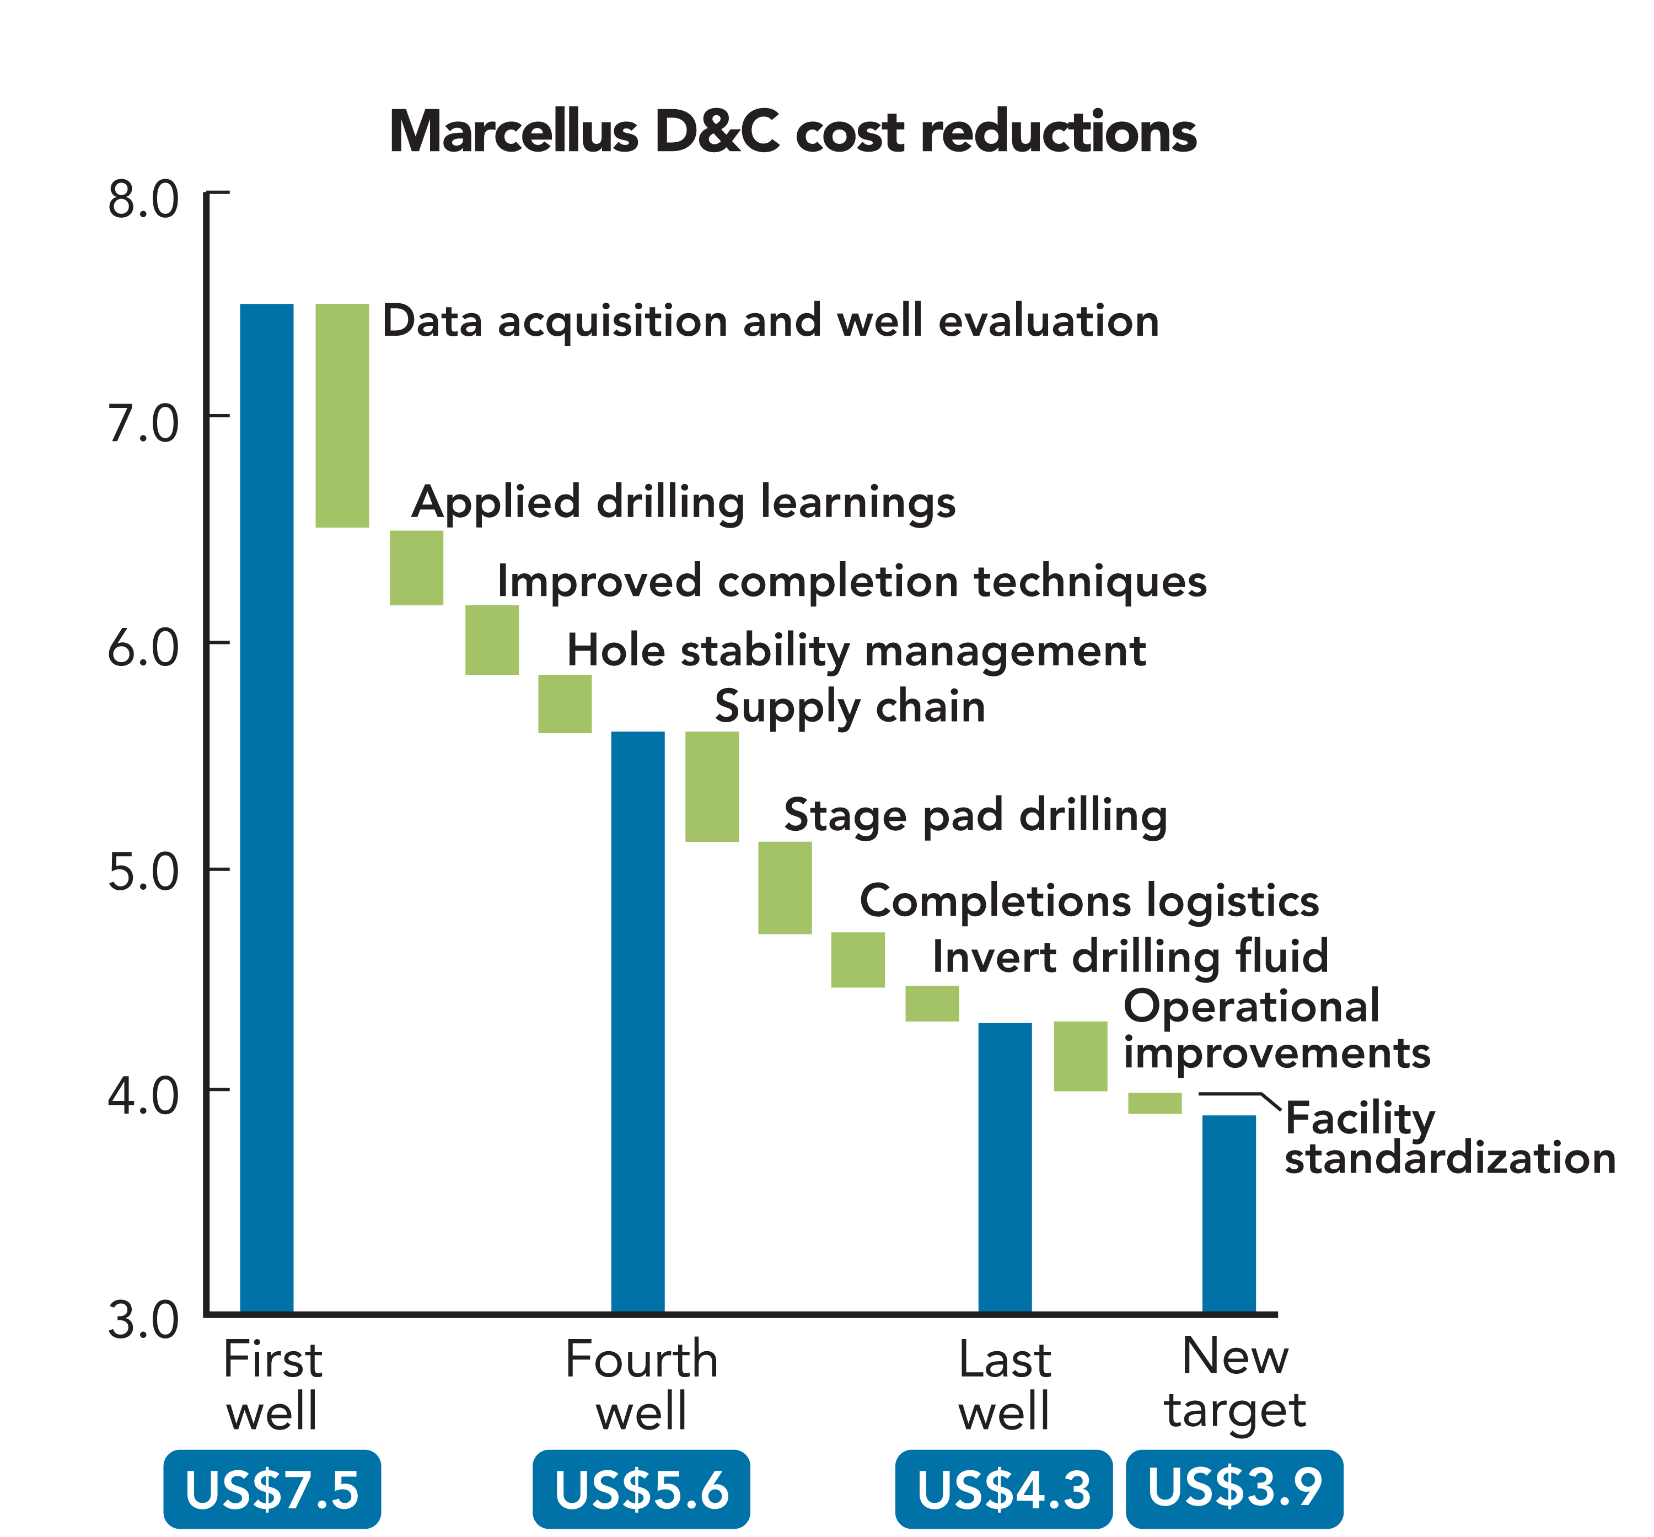
Marcellus Shale - Moore’s Law
Talisman December 2009

Slide 40
Marcellus Shale – Moore’s Law
Range Resources 2016

Slide 41
Utica Shale Gas
Range Resources 2016

Slide 42
West Virginia Gas Production

Slide 43
West Virginia Gas Production

Slide 44
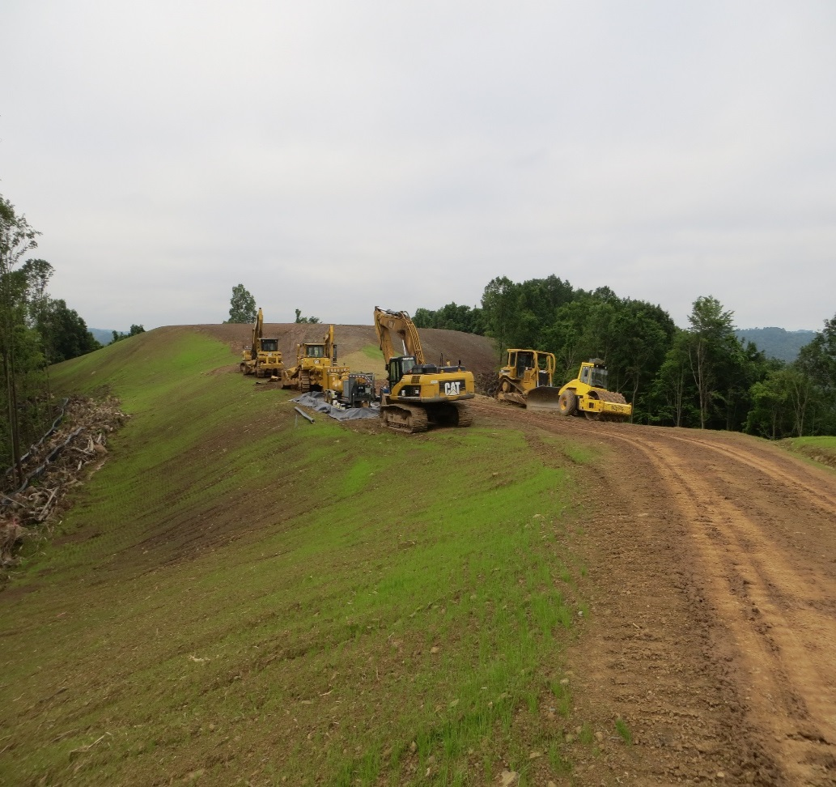
Land Use
Unconventional development has surface impacts
Majority during initial stage of development – clearing of pad and associated infrastructure
Shawn Grushecky– WVU

Slide 45
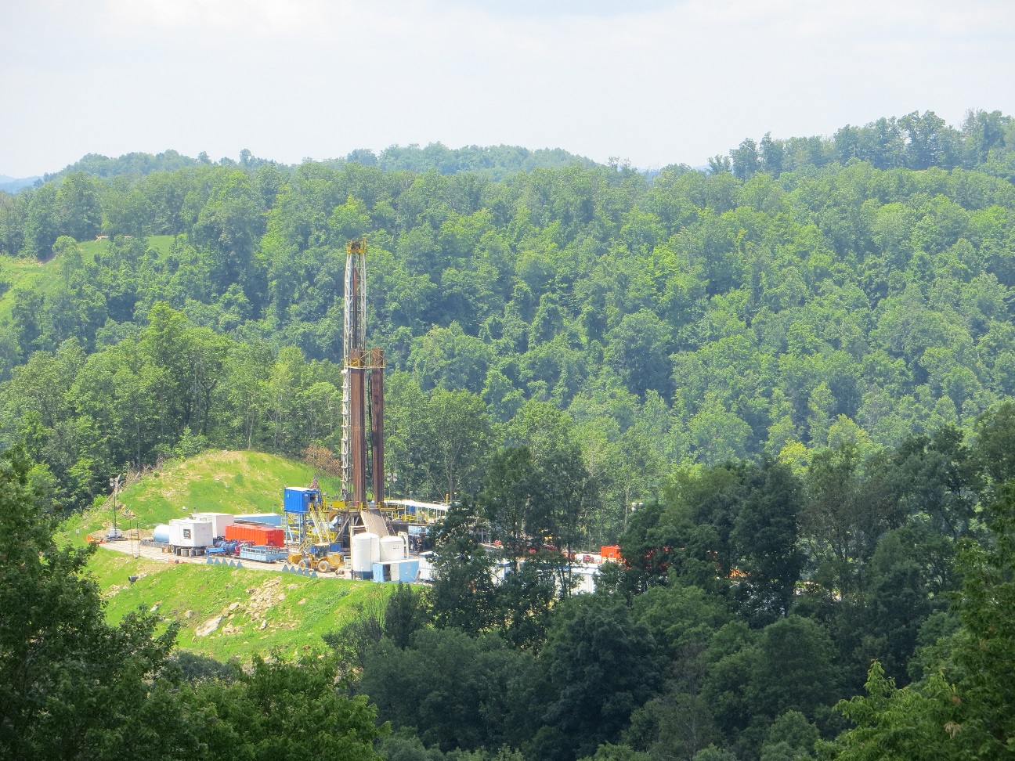
Surface Impacts
Want to quantify impacts over time
Compare with conventional development
Shawn Grushecky– WVU

Slide 46
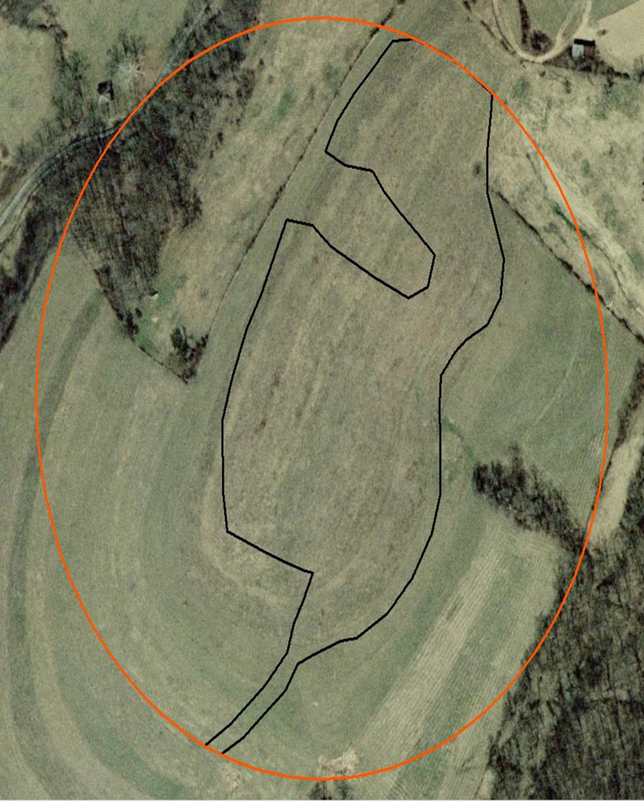
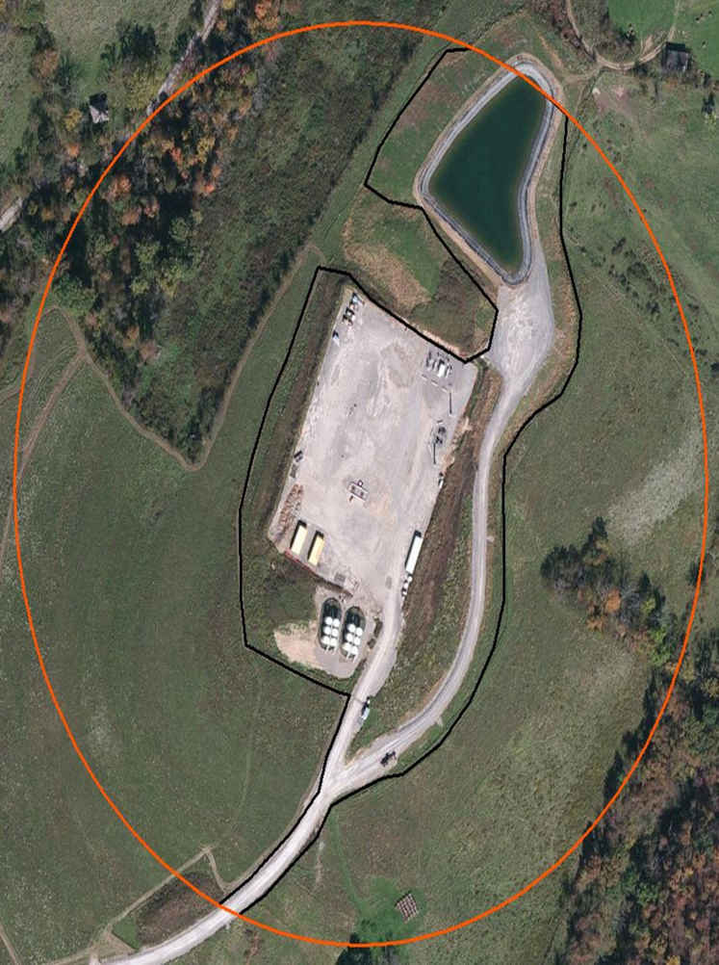
Comparison – Pre/Post imagery
Shawn Grushecky– WVU

Slide 47
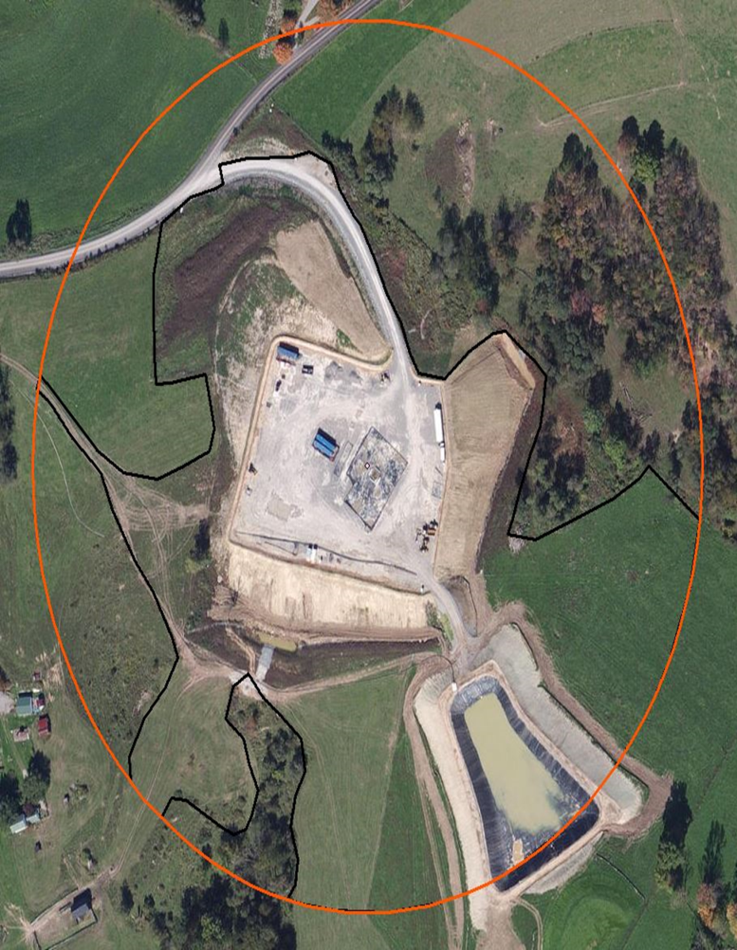
Results
Total of 421 unconventional wells were analyzed
On average total disturbed area was 3.5 ha (8.8 acres)
Shawn Grushecky– WVU

Slide 48
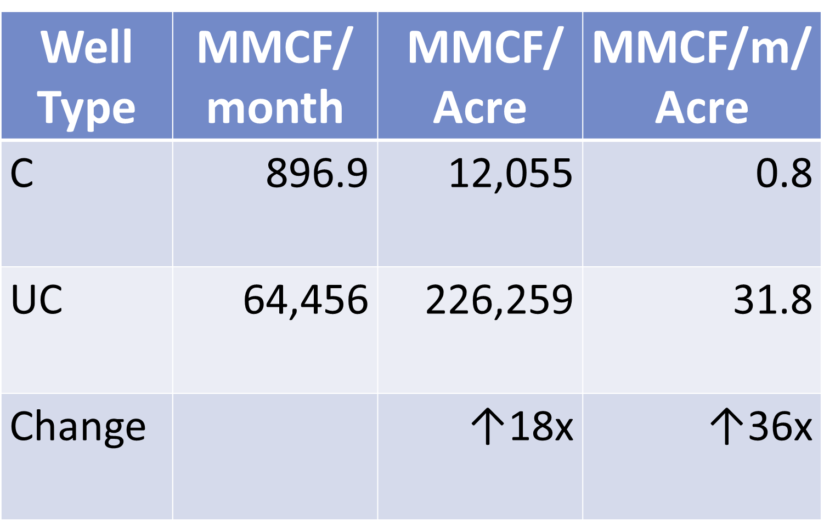
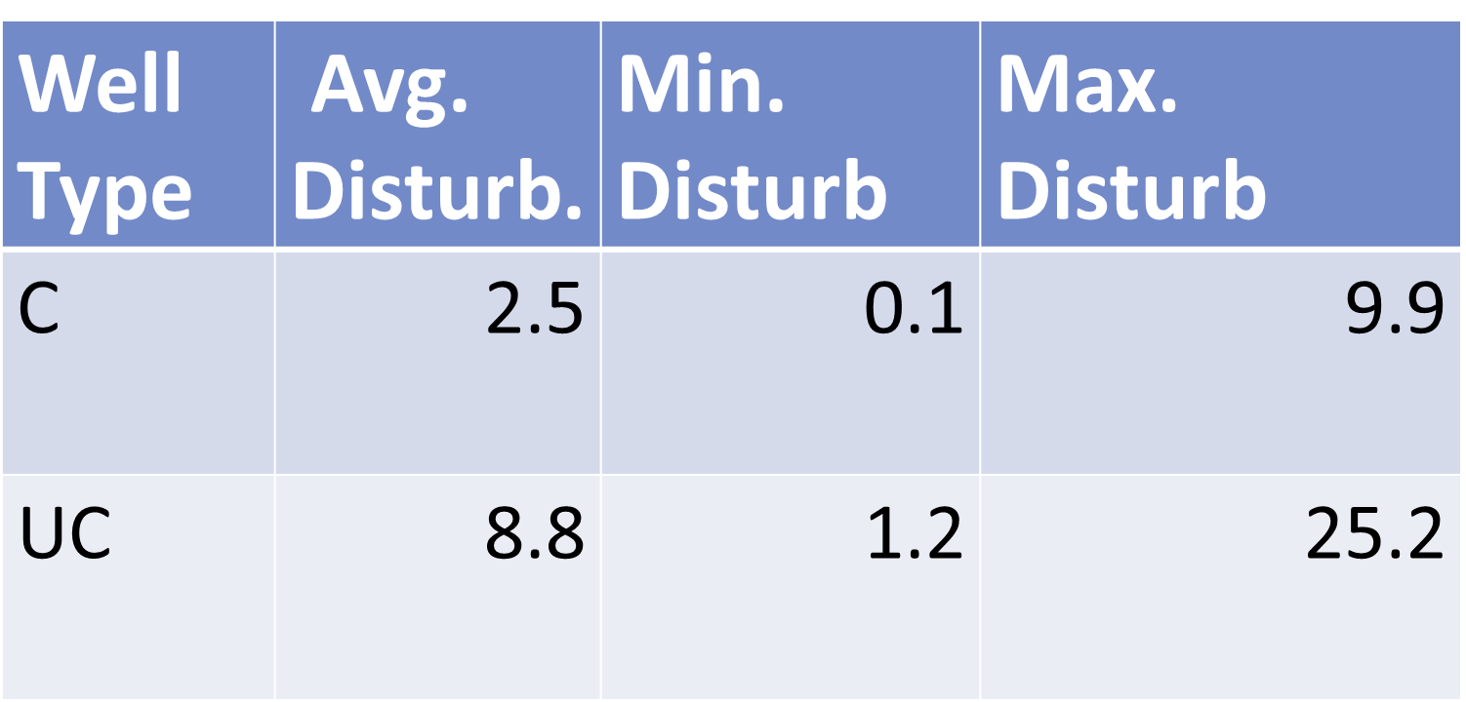
Conventional Versus Unconventional (acres)
Shawn Grushecky– WVU

Slide 49

Marcellus Shale Energy and Environment Laboratory
MSEEL
The objective of the Marcellus Shale Energy and Environment Laboratory (MSEEL) is to provide a long-term collaborative field site to develop and validate new knowledge and technology to improve recovery efficiency and minimize environmental implications of unconventional resource development

Slide 50
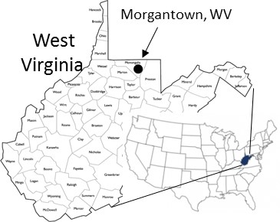
MSEEL Site
Notes:
In the summer months (no heating load) ranges from 2000 mcf to 6000 mcf per day. On a peak winter day the usage is between 35,000 mcf and 45,000 mcf per day.
If you need more precise numbers ‑ let me know.
Hope you are doing well and glad to see Northeast drilling in Morgantown. Not making out so well in Charleston with your legislator from Morgantown
Bob

Slide 51
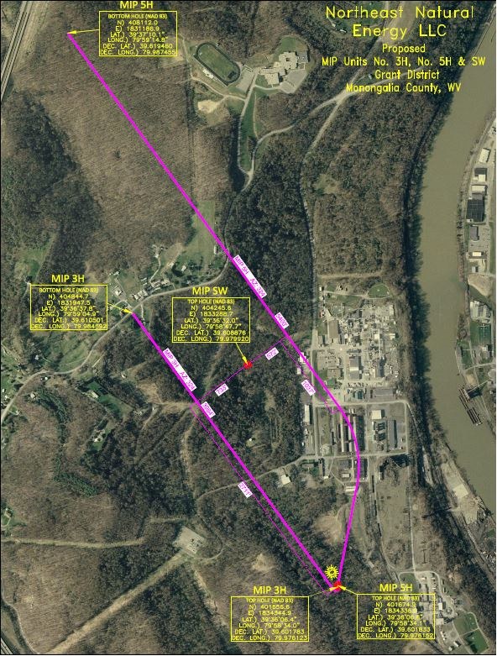
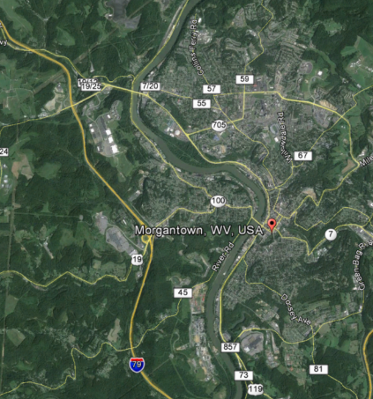
MSEEL Site
WVU
2.5 miles
MSEEL
Notes:
In the summer months (no heating load) ranges from 2000 mcf to 6000 mcf per day. On a peak winter day the usage is between 35,000 mcf and 45,000 mcf per day.
If you need more precise numbers ‑ let me know.
Hope you are doing well and glad to see Northeast drilling in Morgantown. Not making out so well in Charleston with your legislator from Morgantown
Bob

Slide 52
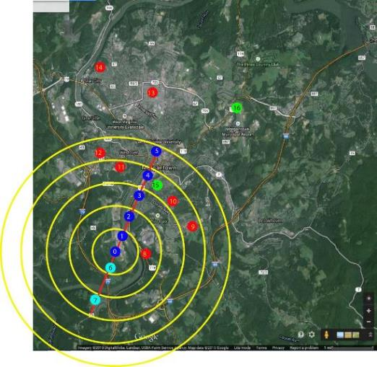
MSEEL Environmental Monitoring
Air Emissions
Michael McCawley – WVU
Derek Johnson – WVU

Slide 53
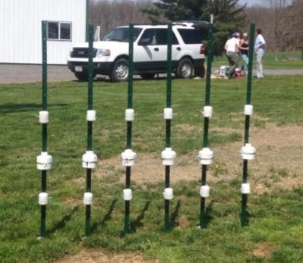
MSEEL Environmental Monitoring
Air Emissions
Emily Elliot – PITT

Slide 54
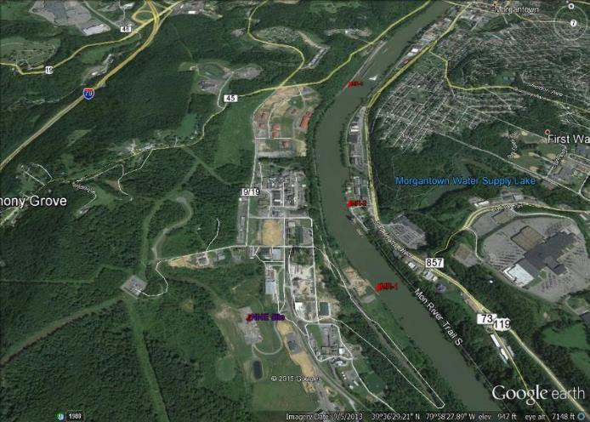
Environmental Monitoring
Surface Water
“To reiterate, there is nothing in our testing to indicate that Morgantown’s drinking water is unsafe, and we will continue to monitor, paying close attention to potential contamination from wells, to ensure it stays that way.” – Paul Ziemkiewicz
Paul Ziemkiewicz / WVU-WVWRI

Slide 55
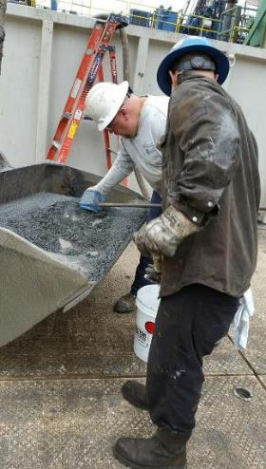
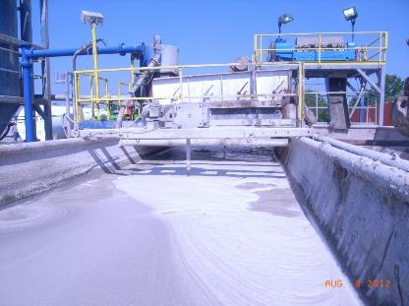
Drilling and Produced Water
Waste Monitoring
Cuttings
Mud

Slide 56
Using ‘Green’ Drilling Mud
NO Parameters Exceeded TCLP
In the Vertical and Horizontal (Marcellus) sections:
TCLP organics-no exceedances
TCLP inorganics-no exceedances
TCLP - Toxicity Characteristic Leaching Procedure
Better Drilling Performance with Steerable Bit
2011 – 3,000 feet curve & lateral in 30 days
2015 – 6,500 feet curve & lateral in 5 days
Paul Ziemkiewicz – WVU/WVWRI
Notes:
Toxicity characteristic leaching procedure

Slide 57
Radiochemistry: Drill Cuttings
Brazil nuts are about 12 pCi/g
Paul Ziemkiewicz – WVU/WVWRI

Slide 58
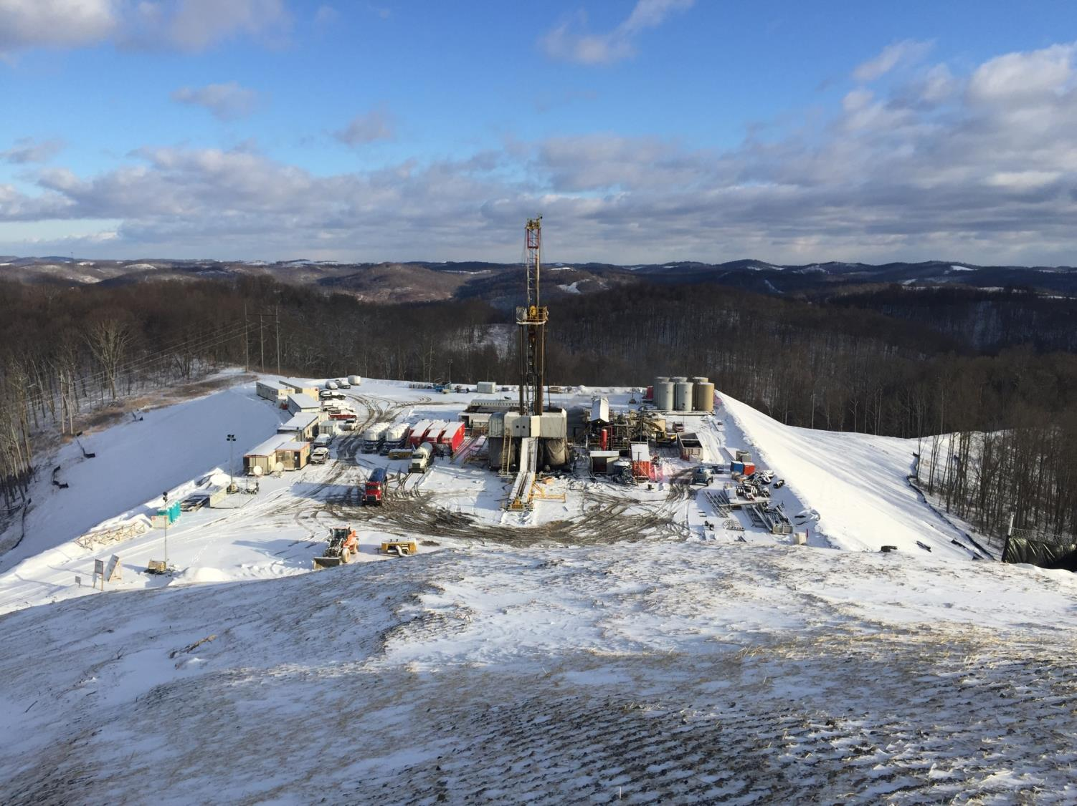

Building Partnerships for Research, Education, and Outreach
Industry
MSEEL
Community
Academia
Government
Tim Carr
Phone: 304.293.9660
Email: tim.carr@mail.wvu.edu

